Slide 1


Criminal Code Summarization and Outcome Prediction Using InLegalBERT and Bharatiya Nyaya Sanhita Mapping
St. Francis Institute of Technology
Department of Computer Engineering
Group Members
Name | Roll No.
Samit Fernandes | 03
Jaden Franco | 04
Ralph Pereira | 19

Slide 2
Content
Introduction
Existing System
Literature Review
Problem definition
Proposed Solution
Flowchart
Experimental Setup
Output
Conclusion
References
Notes:
The template given should be strictly adhered to.
If for the sake of explanation the students wants to provide extra animation they are at the liberty to do so.

Slide 3
Introduction
The Bharatiya Nyaya Sanhita (BNS) Act introduces a modernized legal framework, replacing the long-standing Indian Penal Code (IPC), which has faced challenges due to outdated language and complex classifications.
The BNS Act simplifies these classifications, aiming to enhance accessibility, efficiency, and relevance in criminal law processes.
The transition to the BNS framework presents challenges for legal professionals who rely on IPC-based tools, as existing systems are not compatible with the new framework.
Notes:
Talk about the domain area briefly
U may choose to use any diagrammatic representations or graphical input to substantiate your views about the problem
The

Slide 4
Introduction
There is a need for BNS-specific tools and datasets to assist with tasks such as legal document summarization, section mapping, and case outcome prediction.
This project aims to bridge the gap by creating a structured dataset and a rule-based mapping strategy to align IPC sections with their BNS equivalents, improving legal document processing under the new BNS framework.
Notes:
Talk about the domain area briefly
U may choose to use any diagrammatic representations or graphical input to substantiate your views about the problem
The

Slide 5
Existing System
Existing systems are designed for IPC-based analysis and lack the structural adjustments needed for the BNS Act, resulting in a lack of BNS-compatible datasets.
There is no systematic mapping of IPC sections to their BNS equivalents, making it difficult to interpret or apply historical data within the new framework.
Current legal document summarization models are tailored to IPC-based cases, failing to align with the simplified classifications of BNS.
Notes:
Talk about the domain area briefly
U may choose to use any diagrammatic representations or graphical input to substantiate your views about the problem
The

Slide 6
Literature Review
Paul, et al. [1] retrained LegalBERT and CaseLawBERT on Indian legal data, finding that InLegalBERT showed significant improvements in legal document summarization, especially in understanding legal terminology and context.
S. Sharma et al. [2] explores using InLegalBERT for legal document summarization. Evaluated against Legal Pegasus, T5 base, BART, and BERT using ROUGE-L F1 scores, InLegalBERT achieves the best performance for Indian legal texts.
Notes:
Talk about the domain area briefly
U may choose to use any diagrammatic representations or graphical input to substantiate your views about the problem
The

Slide 7
Literature Review
Rani, U. and Bidhan, K. [3] provides a comparative analysis of various extractive summarization techniques, including TextRank, TF-IDF, and LDA, evaluating their effectiveness in condensing textual content, especially in contexts requiring concise and relevant summaries .
Notes:
Talk about the domain area briefly
U may choose to use any diagrammatic representations or graphical input to substantiate your views about the problem
The

Slide 8
Problem Definition
The shift from IPC to BNS creates challenges in legal document analysis due to the lack of a BNS-specific dataset and tools. Existing systems, designed for IPC, cannot efficiently handle the new BNS structure, hindering tasks like summarization, section mapping, and outcome prediction. This highlights the need for tailored tools and datasets to support legal analysis under the BNS framework.
Notes:
Talk about the domain area briefly
U may choose to use any diagrammatic representations or graphical input to substantiate your views about the problem
The

Slide 9
Proposed Solution
Create synthetic BNS dataset mapping IPC to BNS
Use InLegalBERT for generating embeddings for extractive summarization
Fine-tune BART for abstractive summarization
Present case findings in detail
Rule-based IPC to BNS mapping
Notes:
Talk about the domain area briefly
U may choose to use any diagrammatic representations or graphical input to substantiate your views about the problem
The

Slide 10
Proposed Solution
Create synthetic BNS dataset mapping IPC to BNS
Since no official BNS dataset exists, a synthetic dataset was created.
IPC sections were manually mapped to their corresponding BNS sections.
This dataset serves as the foundation for training and testing the system on BNS cases.
Ensures structured analysis and continuity between IPC and BNS cases.
Notes:
Talk about the domain area briefly
U may choose to use any diagrammatic representations or graphical input to substantiate your views about the problem
The

Slide 11
Proposed Solution
Use InLegalBERT for generating embeddings for extractive summarization
InLegalBERT, a legal-domain pre-trained model, is used for sentence embedding.
Each sentence from the legal document is transformed into a dense vector.
Sentence similarity is computed using embeddings to select key sentences.
Helps extract the most relevant parts of the document while preserving legal meaning.
Notes:
Talk about the domain area briefly
U may choose to use any diagrammatic representations or graphical input to substantiate your views about the problem
The

Slide 12
Proposed Solution
Fine-tune BART for abstractive summarization
A fine-tuned BART model (facebook/bart-large) is used for summarization.
Extracted sentences are further processed to generate human-like, rephrased summaries.
BART handles complex legal terminologies and produces coherent, fluent summaries.
This improves readability without losing important legal facts.
Notes:
Talk about the domain area briefly
U may choose to use any diagrammatic representations or graphical input to substantiate your views about the problem
The

Slide 13
Proposed Solution
Present case findings in detail
After summarization, detailed case analysis is performed.
Important aspects like case background, evidence, legal sections, and outcomes are extracted.
Summarization is complemented with IPC and BNS code references.
Helps legal professionals understand the case in a concise but informative manner.
Notes:
Talk about the domain area briefly
U may choose to use any diagrammatic representations or graphical input to substantiate your views about the problem
The

Slide 14
Proposed Solution
Rule-based IPC to BNS mapping
A rule-based system identifies IPC sections in the text using regex and NER (Named Entity Recognition).
It then maps them automatically to the corresponding BNS sections.
The mapping ensures that legal documents can be interpreted accurately under the new BNS framework.
This strategy bridges the gap between historical IPC cases and the new legal structure.
Notes:
Talk about the domain area briefly
U may choose to use any diagrammatic representations or graphical input to substantiate your views about the problem
The

Slide 15
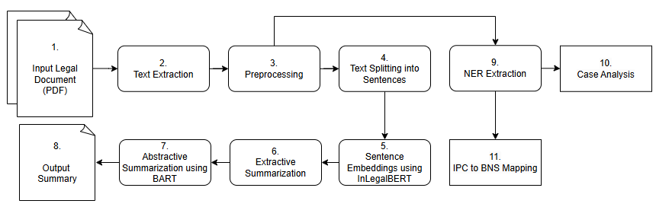
Flowchart
fig. (1) Flowchart for document summarization and sections mapping
Notes:
Talk about the domain area briefly
U may choose to use any diagrammatic representations or graphical input to substantiate your views about the problem
The

Slide 16
Flowchart
Input Legal Document
Text Extraction from the document
Preprocessing (cleaning, formatting)
Text Splitting into sentences
Sentence Embeddings using InLegalBERT
Extractive Summarization
Abstractive Summarization using BART
Output Final Summary
Notes:
Talk about the domain area briefly
U may choose to use any diagrammatic representations or graphical input to substantiate your views about the problem
The

Slide 17
Flowchart
NER Extraction (find legal entities like dates, sections)
Case Analysis (case details, outcomes)
IPC to BNS Mapping (update legal sections)
Notes:
Talk about the domain area briefly
U may choose to use any diagrammatic representations or graphical input to substantiate your views about the problem
The

Slide 18
Experimental Setup
Dataset: 7100 Indian Supreme Court judgments
Models Used:
InLegalBERT (Extractive Summarization)
Facebook/BART- (Abstractive Summarization)
Evaluation Metrics: ROUGE, BLEU, METEOR, BERTScore
Hardware: Windows 11, 16GB RAM, Ryzen 6800H, RTX 3050 GPU
Notes:
Talk about the domain area briefly
U may choose to use any diagrammatic representations or graphical input to substantiate your views about the problem
The

Slide 19
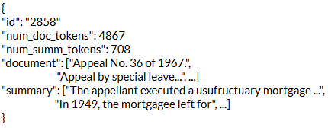
Experimental Setup
Dataset :
Data Source: The dataset was created from 7.1k Indian Supreme Court case documents.
Data Splits: The data is divided into two splits: 'train' (7k docs) and 'test' (100 docs).
Data Instance: An example from 'train' looks as follows:
fig. (2) Dataset Instance Example
Notes:
Talk about the domain area briefly
U may choose to use any diagrammatic representations or graphical input to substantiate your views about the problem
The

Slide 20
Experimental Setup
Models Used:
InLegalBERT (Extractive Summarization)
This model is used to generate legal sentence embeddings for extractive summary.
The model has the configuration:
12 hidden layers
768 hidden dimensionality
12 attention heads
~110M parameters.
https://huggingface.co/law-ai/InLegalBERT
Notes:
Talk about the domain area briefly
U may choose to use any diagrammatic representations or graphical input to substantiate your views about the problem
The

Slide 21
Experimental Setup
Models Used:
Facebook/BART- (Abstractive Summarization)
This model is a large variant of BART and is effective for text generation
The model has the configuration:
12 hidden layers in the encoder and decoder
1024 hidden dimensionality
16 attention heads
~406M parameters.
https://huggingface.co/facebook/bart-large
Notes:
Talk about the domain area briefly
U may choose to use any diagrammatic representations or graphical input to substantiate your views about the problem
The

Slide 22
Experimental Setup
Evaluation Metrics
ROUGE (Recall-Oriented Understudy for Gisting Evaluation)
ROUGE-1: Measures unigram (single word) overlap between generated and reference summaries.
ROUGE-2: Measures bigram (two consecutive words) overlap.
ROUGE-L: Measures the longest common subsequence of words, reflecting sentence-level structure.
Notes:
Talk about the domain area briefly
U may choose to use any diagrammatic representations or graphical input to substantiate your views about the problem
The

Slide 23
Experimental Setup
Evaluation Metrics
BLEU (Bilingual Evaluation Understudy)
Checks how many matching n-grams (phrases) exist between generated and reference summaries.
METEOR (Metric for Evaluation of Translation with Explicit ORdering)
Considers synonym matching, word order, and stemming for better fluency evaluation.
BERTScore
Uses contextual word embeddings to measure how semantically similar the summaries are.
Notes:
Talk about the domain area briefly
U may choose to use any diagrammatic representations or graphical input to substantiate your views about the problem
The

Slide 24
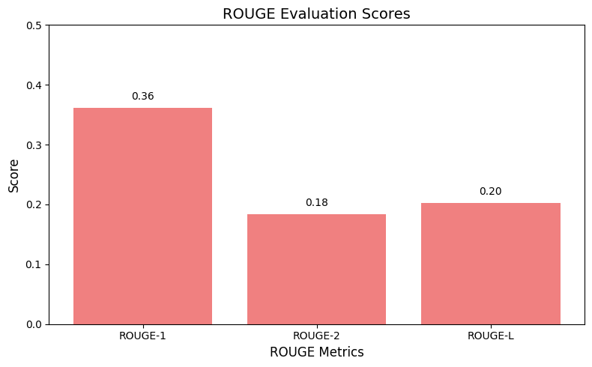
Output
Fine-Tuned BART model evaluation results
fig. (3) ROUGE evaluations of fine-tuned BART model
Notes:
Talk about the domain area briefly
U may choose to use any diagrammatic representations or graphical input to substantiate your views about the problem
The

Slide 25
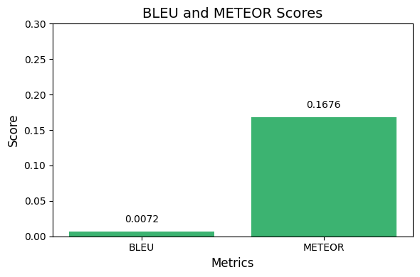
Output
Fine-Tuned BART model evaluation results
fig. (4) BLEU & METEOR evaluations of fine-tuned BART model
Notes:
Talk about the domain area briefly
U may choose to use any diagrammatic representations or graphical input to substantiate your views about the problem
The

Slide 26
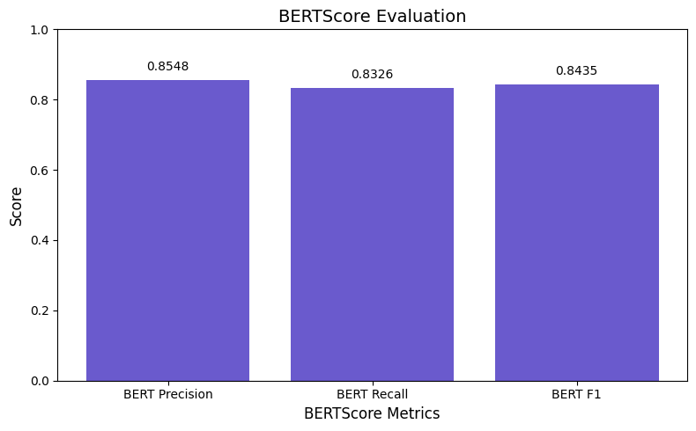
Output
Fine-Tuned BART model evaluation results
fig. (5) BERTScore evaluations of fine-tuned BART model
Notes:
Talk about the domain area briefly
U may choose to use any diagrammatic representations or graphical input to substantiate your views about the problem
The

Slide 27
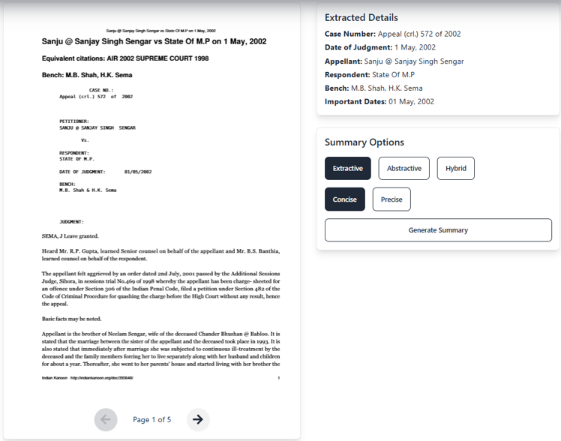
Output
Case Analysis
User uploads the legal document and gets the case details, as seen in ‘Extracted Details’ section,
followed by summary options selection
fig. (6) Document upload and summary option selection
Notes:
Talk about the domain area briefly
U may choose to use any diagrammatic representations or graphical input to substantiate your views about the problem
The

Slide 28
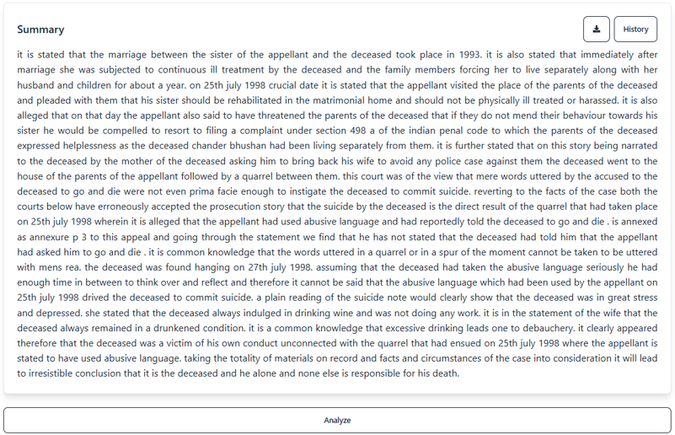
Output
Case Analysis
After selecting, desired summary options, user gets the summary by clicking on ‘Generate Summary’ button User can get detailed analysis by clicking ‘Analyze’
fig. (7) Generated Summary
Notes:
Talk about the domain area briefly
U may choose to use any diagrammatic representations or graphical input to substantiate your views about the problem
The

Slide 29
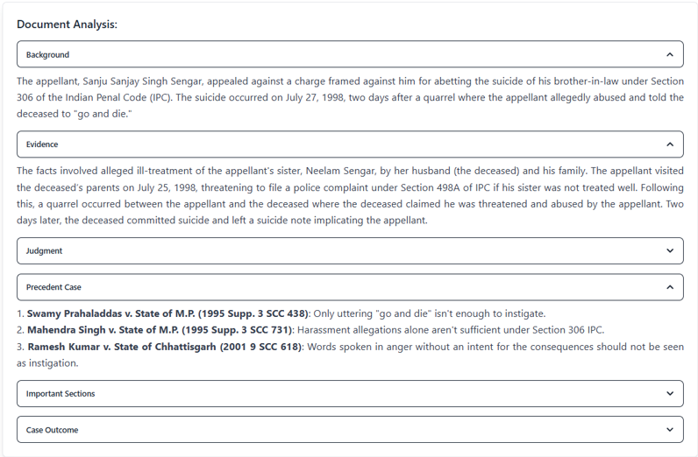
Output
Case Analysis
User gets detailed analysis of the case, like background, evidences, judgment, case outcome, etc.
fig. (8) Case analysis of document
Notes:
Talk about the domain area briefly
U may choose to use any diagrammatic representations or graphical input to substantiate your views about the problem
The

Slide 30
Conclusion
The project developed an efficient system for legal document summarization and analysis under the Bharatiya Nyaya Sanhita (BNS) framework. By fine-tuning InLegalBERT and BART models, the system ensures accurate section mapping, case analysis, and outcome prediction. It helps legal professionals transition smoothly from IPC to BNS and lays the foundation for future advancements in legal technology.
Notes:
Talk about the domain area briefly
U may choose to use any diagrammatic representations or graphical input to substantiate your views about the problem
The

Slide 31
References
Paul, S. et al. (2023) “Pre-trained language models for the le-gal domain: A case study on indian law”, Available at: https://arxiv.org/abs/2209.06049.
S. Sharma, S. Srivastava, P. Verma, A. Verma, and Sachchida Nand Chaurasia (2023) “A Comprehensive Analysis of Indian Legal Documents Summarization Technique,” https://doi.org/10.1007/s42979-023-01983-y
Rani, U. and Bidhan, K. (2021a) “Comparative assessment of extractive summarization: TextRank, TF-IDF and LDA”, Journal of scientific research, doi:10.37398/jsr.2021.650140.
Notes:
Talk about the domain area briefly
U may choose to use any diagrammatic representations or graphical input to substantiate your views about the problem
The

Slide 32
References
https://huggingface.co/law-ai/InLegalBERT
https://huggingface.co/facebook/bart-large
https://huggingface.co/datasets/Exploration-Lab/IL-TUR
https://cookbook.openai.com/examples/evaluation/how_to_eval_abstractive_summarization?ref=blog.mozilla.ai
Notes:
Talk about the domain area briefly
U may choose to use any diagrammatic representations or graphical input to substantiate your views about the problem
The

